Slide 1
Chapter 5: Ethernet
Introduction to Networks v5.1

Slide 2
Chapter Outline
5.0 Introduction
5.1 Ethernet Protocol
5.2 LAN Switches
5.3 Address Resolution Protocol
5.4 Summary

Slide 3
Section 5.1: Ethernet Protocol
Upon completion of this section, you should be able to:
Explain how the Ethernet sublayers are related to the frame fields.
Describe the Ethernet MAC address.

Slide 4
Topic 5.1.1: Ethernet Frame

Slide 5
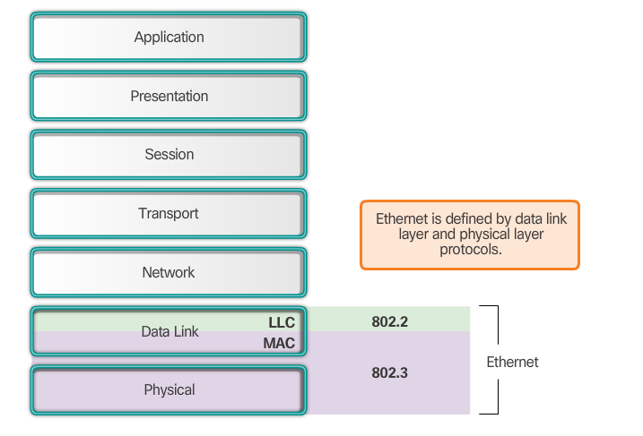
Ethernet Encapsulation
Notes:
5.1.1.1 Communication Fundamentals

Slide 6
Ethernet Encapsulation (cont.)
Ethernet
Most widely used LAN technology
Operates in the data link layer and the physical layer
Family of networking technologies that are defined in the IEEE 802.2 and 802.3 standards
Supports data bandwidths of 10, 100, 1000, 10,000, 40,000, and 100,000 Mbps (100 Gbps)
Ethernet standards
Define Layer 2 protocols and Layer 1 technologies
Two separate sub layers of the data link layer to operate - Logical link control (LLC) and the MAC sublayers
Notes:
5.1.1.1 Ethernet Encapsulation (Cont.)

Slide 7
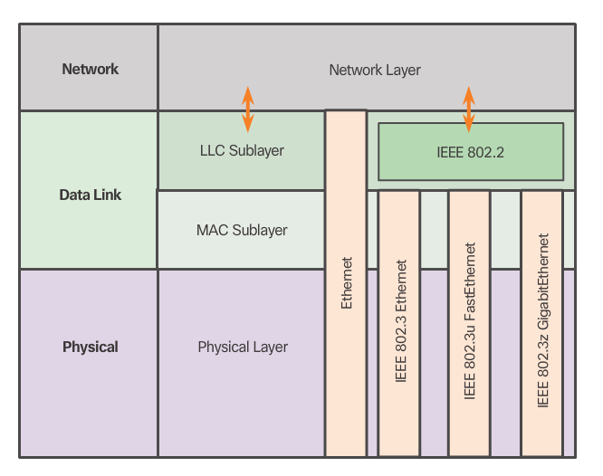
Ethernet Encapsulation(cont.)
Notes:
5.1.1.1 Communication Fundamentals (Cont.)

Slide 8
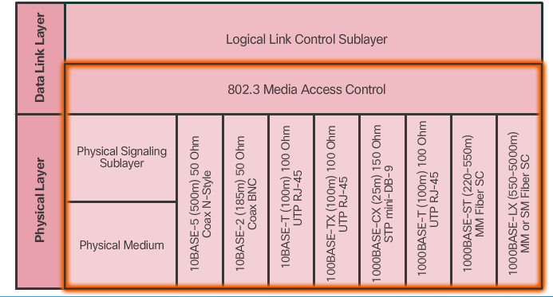
Mac Sublayer
Primary responsibilities:
Data encapsulation
Media access control
Notes:
5.1.1.2 Mac Sublayer

Slide 9
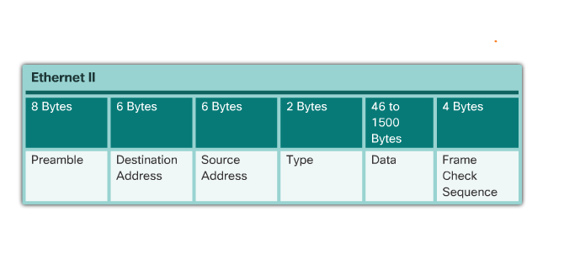
Ethernet Evolution
Ethernet II Frame Structure and Field Size
Notes:
5.1.1.3 Ethernet Evolution

Slide 10
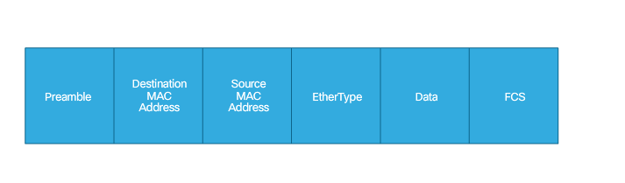
Ethernet II Frame Fields
Minimum Ethernet frame size is 64 bytes (Collision Frame or Runt)
Maximum Ethernet frame size is 1518 bytes (Jumbo or Baby Giant)
Notes:
5.1.1.4 Ethernet II Frame Fields
5.1.1.5 Activity – MAC and LLC Sublayers
5.1.1.6 Activity – Ethernet Frame Fields
5.1.1.7 Lab – Using Wireshark to Examinr Ethernet Frames

Slide 11
Topic 5.1.2: Ethernet MAC Address

Slide 12
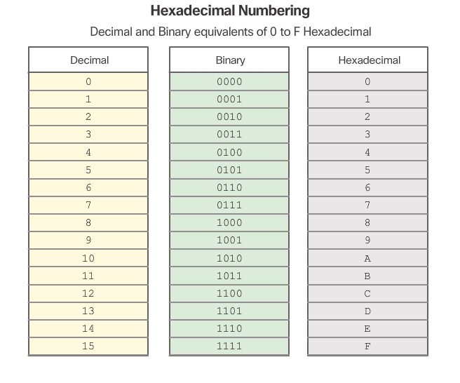
MAC Address and Hexadecimal
Notes:
5.1.2.1 MAC Address and Hexadecimal

Slide 13

MAC Address and Hexadecimal (cont.)
Notes:
5.1.2.1 MAC Address and Hexadecimal (Cont.)

Slide 14
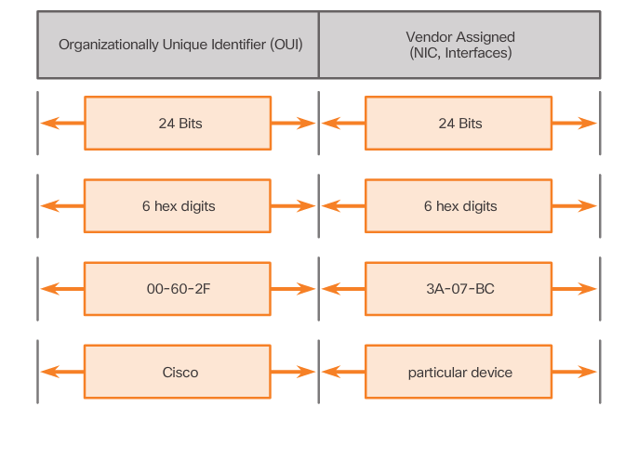
MAC Address: Ethernet Identity
Layer 2 Ethernet MAC address is a 48-bit binary value expressed as 12 hexadecimal digits.
IEEE requires a vendor to follow two simple rules:
Must use that vendor's assigned OUI as the first three bytes.
All MAC addresses with the same OUI must be assigned a unique value in the last three bytes.
Notes:
5.1.2.2 MAC Address Ethernet Identity

Slide 15
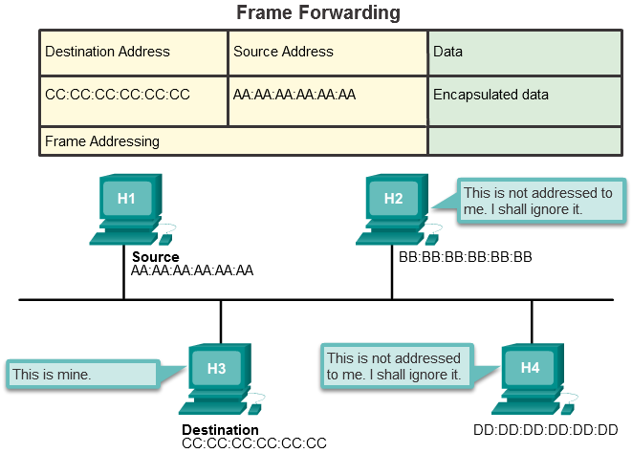
Frame Processing
Notes:
5.1.2.3 Frame Processing

Slide 16
Frame Processing (cont.)
The NIC views information to see if the destination MAC address in the frame matches the device’s physical MAC address stored in RAM.
If there is no match, the device discards the frame.
If there is a match, the NIC passes the frame up the OSI layers, where the de-encapsulation process takes place.
Notes:
5.1.2.3 Frame Processing (Cont.)

Slide 17
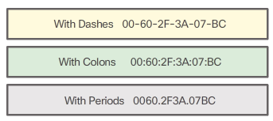
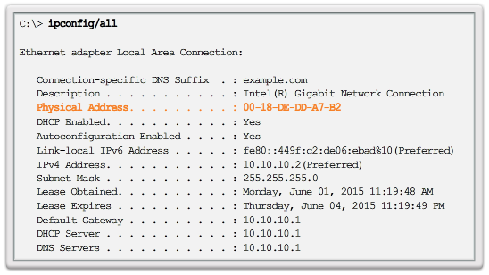
MAC Address Representations
Notes:
5.1.2.4 MAC Address Representations

Slide 18
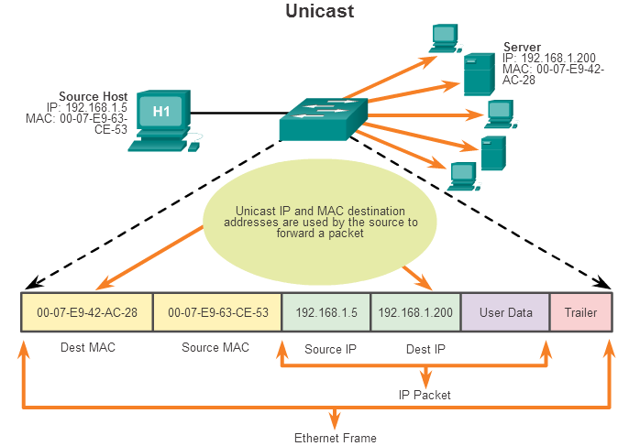
Unicast MAC Address
Notes:
5.1.2.5 Unicast MAC Address

Slide 19
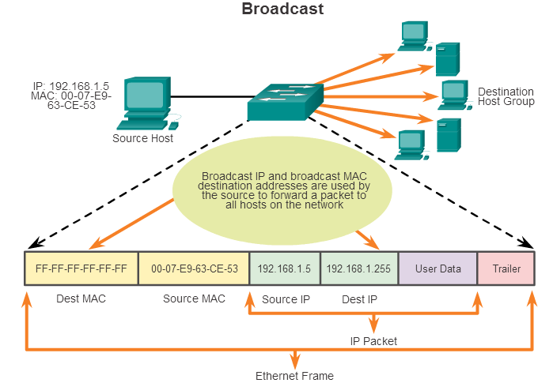
Broadcast MAC Address
Notes:
5.1.2.6 Broadcast MAC Address

Slide 20
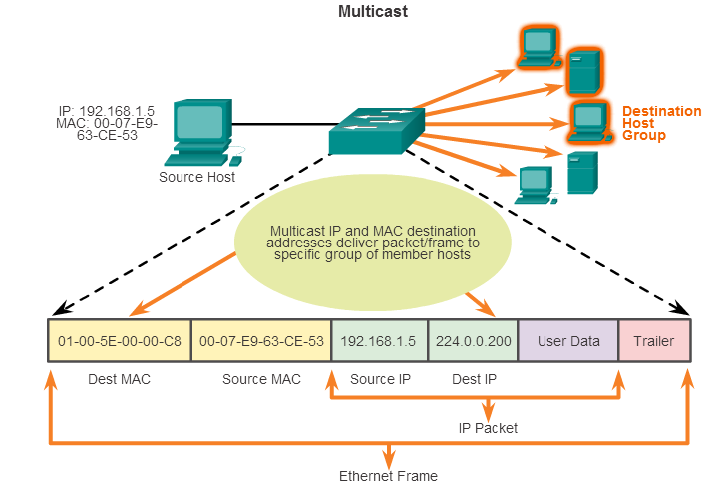
Multicast MAC Address
Notes:
5.1.2.7 Multicast MAC Address
5.1.2.8 Lab - Viewing Network Device MAC Addresses

